Slide 1
MODULE-II
Module II | REQUIREMENTS ENGINEERING AND MODELING | (09Period)
Requirements Engineering: Functional and non-functional requirements, The software requirements document, Requirements specifications, Requirements engineering processes, Requirements elicitation and analysis, Requirements validation, Requirements management. Requirements Modeling: Requirements Analysis, Data Modeling Concepts, Flow-Oriented Modeling, Scenario based Modeling, UML Models that supplement the Use Case Case study on Requirements modeling for Web and MobileApps.

Slide 2
FUNCTIONAL & NON FUNCTIONAL REQUIREMENTS
Functional Requirements: These are the requirements that the end user specifically demands as basic facilities that the system should offer.
All these functionalities need to be necessarily incorporated into the system as a part of the contract. These are represented or stated in the form of input to be given to the system, the operation performed and the output expected.
They are basically the requirements stated by the user which one can see directly in the final product, unlike the non-functional requirements.

Slide 3
FUNCTIONAL & NON FUNCTIONAL REQUIREMENTS
Non-functional requirements: These are basically the quality constraints that the system must satisfy according to the project contract.
The priority or extent to which these factors are implemented varies from one project to other. They are also called non-behavioral requirements.

Slide 4
FUNCTIONAL & NON FUNCTIONAL REQUIREMENTS
They basically deal with issues like:
Portability
Security
Maintainability
Reliability
Scalability
Performance
Reusability
Flexibility

Slide 5
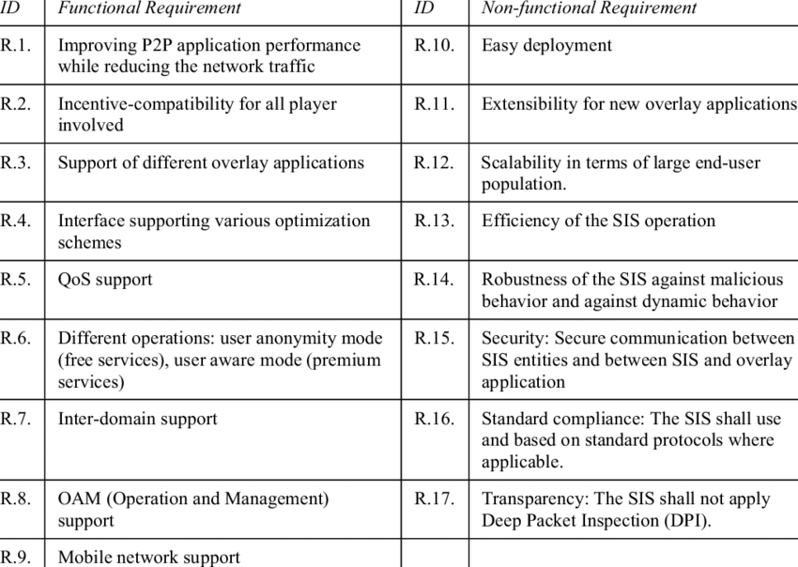
FUNCTIONAL & NON FUNCTIONAL REQUIREMENTS

Slide 6
THE SOFTWARE REQUIREMENTS DOCUMENT
Documentation ensures that the software development team or other stakeholders are on the same page regarding what needs to be built and are fully aware of the goal, scope, functional requirements, challenges, and budget regarding the software.
(i) Purpose of this Document –
At first, main aim of why this document is necessary and what’s purpose of document is explained and described.
(ii) Scope of this document –
In this, overall working and main objective of document and what value it will provide to customer is described and explained. It also includes a description of development cost and time required.

Slide 7
THE SOFTWARE REQUIREMENTS DOCUMENT
(iii) Overview –
In this, description of product is explained. It’s simply summary or overall review of product.
General description :
In this, general functions of product which includes objective of user, a user characteristic, features, benefits, about why its importance is mentioned. It also describes features of user community.
Functional Requirements :
In this, possible outcome of software system which includes effects due to operation of program is fully explained. All functional requirements which may include calculations, data processing, etc. are placed in a ranked order.

Slide 8
THE SOFTWARE REQUIREMENTS DOCUMENT
Interface Requirements :
In this, software interfaces which mean how software program communicates with each other or users either in form of any language, code, or message are fully described and explained. Examples can be shared memory, data streams, etc.
Performance Requirements :
In this, how a software system performs desired functions under specific condition is explained. It also explains required time, required memory, maximum error rate, etc.
Design Constraints :
In this, constraints which simply means limitation or restriction are specified and explained for design team. Examples may include use of a particular algorithm, hardware and software limitations, etc.

Slide 9
THE SOFTWARE REQUIREMENTS DOCUMENT
Non-Functional Attributes :
In this, non-functional attributes are explained that are required by software system for better performance. An example may include Security, Portability, Reliability, Reusability, Application compatibility, Data integrity, Scalability capacity, etc.

Slide 10
REQUIREMENTS SPECIFICATION
The production of the requirements stage of the software development process is Software Requirements Specifications (SRS) (also called a requirements document).
This report lays a foundation for software engineering activities and is constructing when entire requirements are elicited and analyzed.
SRS is a formal report, which acts as a representation of software that enables the customers to review whether it (SRS) is according to their requirements. Also, it comprises user requirements for a system as well as detailed specifications of the system requirements.
The SRS is a specification for a specific software product, program, or set of applications that perform particular functions in a specific environment. It serves several goals depending on who is writing it. First, the SRS could be written by the client of a system. Second, the SRS could be written by a developer of the system.

Slide 11
REQUIREMENTS SPECIFICATION
The two methods create entirely various situations and establish different purposes for the document altogether. The first case, SRS, is used to define the needs and expectation of the users. The second case, SRS, is written for various purposes and serves as a contract document between customer and developer.

Slide 12
REQUIREMENTS SPECIFICATION
Following are the features of a good SRS document:
Correctness: User review is used to provide the accuracy of requirements stated in the SRS. SRS is said to be perfect if it covers all the needs that are truly expected from the system.
2. Consistency: The SRS is consistent if, and only if, no subset of individual requirements described in its conflict.
3. Unambiguousness: SRS is unambiguous when every fixed requirement has only one interpretation. This suggests that each element is uniquely interpreted. In case there is a method used with multiple definitions, the requirements report should determine the implications in the SRS so that it is clear and simple to understand.

Slide 13
REQUIREMENTS SPECIFICATION
4. Modifiability: SRS should be made as modifiable as likely and should be capable of quickly obtain changes to the system to some extent. Modifications should be perfectly indexed and cross-referenced.
5. Verifiability: SRS is correct when the specified requirements can be verified with a cost-effective system to check whether the final software meets those requirements. The requirements are verified with the help of reviews.
6.Traceability: The SRS is traceable if the origin of each of the requirements is clear and if it facilitates the referencing of each condition in future development or enhancement documentation.

Slide 14
REQUIREMENTS ENGINEERING PROCESS
Requirement Engineering is the process of defining, documenting and maintaining the requirements. It is a process of gathering and defining service provided by the system. Requirements Engineering Process consists of the following main activities:
Requirements elicitation
Requirements specification
Requirements verification and validation
Requirements management
Requirements Elicitation:
It is related to the various ways used to gain knowledge about the project domain and requirements. The various sources of domain knowledge include customers, business manuals, the existing software of same type, standards and other stakeholders of the project.

Slide 15
REQUIREMENTS ENGINEERING PROCESS
The techniques used for requirements elicitation include interviews, brainstorming, task analysis, Delphi technique, prototyping, etc. Elicitation does not produce formal models of the requirements understood. Instead, it widens the domain knowledge of the analyst and thus helps in providing input to the next stage.
Requirements specification:
This activity is used to produce formal software requirement models. During specification, more knowledge about the problem may be required which can again trigger the elicitation process. The models used at this stage include ER diagrams, data flow diagrams(DFDs), function decomposition diagrams(FDDs), data dictionaries, etc.

Slide 16
REQUIREMENTS ENGINEERING PROCESS
Requirements verification and validation:
Verification: It refers to the set of tasks that ensures that the software correctly implements a specific function.
Validation: It refers to a different set of tasks that ensures that the software that has been built is traceable to customer requirements.
Requirements management:
Requirement management is the process of analyzing, documenting, tracking, prioritizing and agreeing on the requirement and controlling the communication to relevant stakeholders. This stage takes care of the changing nature of requirements. It should be ensured that the SRS is as modifiable as possible so as to incorporate changes in requirements specified by the end users at later stages too.

Slide 17
REQUIREMENTS ELICITATION & ANALYSIS
Requirements elicitation is perhaps the most difficult, most error-prone and most communication intensive software development. It can be successful only through an effective customer-developer partnership. Requirements elicitation includes the subsequent activities. Few of them are listed below –
1. Interviews:
Objective of conducting an interview is to understand the customer’s expectations from the software.
It is impossible to interview every stakeholder hence representatives from groups are selected based on their expertise and credibility.
Interviews maybe be open-ended or structured.
In open-ended interviews there is no pre-set agenda. Context free questions may be asked to understand the problem.
In structured interview, agenda of fairly open questions is prepared. Sometimes a proper questionnaire is designed for the interview.

Slide 18
REQUIREMENTS ELICITATION & ANALYSIS
2. Brainstorming Sessions:
It is a group technique
It is intended to generate lots of new ideas hence providing a platform to share views
A highly trained facilitator is required to handle group bias and group conflicts.
Every idea is documented so that everyone can see it.
Finally, a document is prepared which consists of the list of requirements and their priority if possible.

Slide 19
REQUIREMENTS ELICITATION & ANALYSIS
3. Facilitated Application Specification Technique:
It’s objective is to bridge the expectation gap – difference between what the developers think they are supposed to build and what customers think they are going to get.
A team oriented approach is developed for requirements gathering.
Each attendee is asked to make a list of objects that are-
Part of the environment that surrounds the system
Produced by the system
Used by the system
Each participant prepares his/her list, different lists are then combined, redundant entries are eliminated, team is divided into smaller sub-teams to develop mini-specifications and finally a draft of specifications is written down using all the inputs from the meeting.

Slide 20
REQUIREMENTS ELICITATION & ANALYSIS
4. Quality Function Deployment:
In this technique customer satisfaction is of prime concern, hence it emphasizes on the requirements which are valuable to the customer.
3 types of requirements are identified –
Normal requirements –
In this the objective and goals of the proposed software are discussed with the customer. Example – normal requirements for a result management system may be entry of marks, calculation of results, etc

Slide 21
REQUIREMENTS ELICITATION & ANALYSIS
Expected requirements –
These requirements are so obvious that the customer need not explicitly state them. Example – protection from unauthorized access.
Exciting requirements –
It includes features that are beyond customer’s expectations and prove to be very satisfying when present. Example – when unauthorized access is detected, it should backup and shutdown all processes.

Slide 22
REQUIREMENTS VALIDATION
Requirements validation is the process of checking that requirements defined for development, define the system that the customer really wants.
To check issues related to requirements, we perform requirements validation.
We usually use requirements validation to check error at the initial phase of development as the error may increase excessive rework when detected later in the development process.
In the requirements validation process, we perform a different type of test to check the requirements mentioned in the Software Requirements Specification (SRS), these checks include:

Slide 23
REQUIREMENTS VALIDATION
Completeness checks
Consistency checks
Validity checks
Realism checks
Ambiguity checks
Verifiability

Slide 24
REQUIREMENTS VALIDATION
Test case generation:
Requirement mentioned in SRS document should be testable, the conducted tests reveal the error present in the requirement. It is generally believed that if the test is difficult or impossible to design than, this usually means that requirement will be difficult to implement and it should be reconsidered.
Prototyping:
In this validation techniques the prototype of the system is presented before the end-user or customer, they experiment with the presented model and check if it meets their need.
Requirements Reviews:
In this approach, the SRS is carefully reviewed by a group of people including people from both the contractor organizations and the client side, the reviewer systematically analyses the document to check error and ambiguity.

Slide 25
REQUIREMENTS VALIDATION
Automated Consistency Analysis:
This approach is used for automatic detection of an error, such as non determinism, missing cases, a type error, and circular definitions, in requirements specifications.
First, the requirement is structured in formal notation then CASE tool is used to check in-consistency of the system, The report of all inconsistencies is identified and corrective actions are taken.
Walk-through:
A walkthrough does not have a formally defined procedure and does not require a differentiated role assignment.
Checking early whether the idea is feasible or not.
Obtaining the opinions and suggestion of other people.
Checking the approval of others and reaching an agreement.

Slide 26
REQUIREMENTS MANAGEMENT
Requirements management is important because it empowers everyone to clearly understand stakeholder expectations and confidently deliver a product that has been verified to meet the requirements and validated to meet the needs.
Requirements management is a sophisticated process that includes many moving parts and diverse groups of people.
Typically, the product management department, specifically the product manager, is responsible for the requirements management process.
They work with the stakeholders, including business teams, customers, users, developers, testers, regulators, and quality assurance.

Slide 27
REQUIREMENTS MANAGEMENT
Additionally, a product may have only 100 requirements, or it may have several thousand.
This number will depend on the product’s complexity and level of regulation. With all these elements at play, success hinges on the ability to get everyone on the same page, working toward the same goal.
Therefore, the business value of managing requirements is huge, as successful requirements management is key to project success.
Enhance understanding of stakeholder needs, requirements, and expectations and the problem or opportunity the product means to address

Slide 28
REQUIREMENTS ANALYSIS
Requirement analysis is significant and essential activity after elicitation.
We analyze, refine, and scrutinize the gathered requirements to make consistent and unambiguous requirements. This activity reviews all requirements and may provide a graphical view of the entire system.
After the completion of the analysis, it is expected that the understandability of the project may improve significantly. Here, we may also use the interaction with the customer to clarify points of confusion and to understand which requirements are more important than others.

Slide 29
REQUIREMENTS ANALYSIS
Draw the context diagram:
The context diagram is a simple model that defines the boundaries and interfaces of the proposed systems with the external world. It identifies the entities outside the proposed system that interact with the system.
(ii) Development of a Prototype (optional):
One effective way to find out what the customer wants is to construct a prototype, something that looks and preferably acts as part of the system they say they want.

Slide 30
REQUIREMENTS ANALYSIS
(iii) Model the requirements:
This process usually consists of various graphical representations of the functions, data entities, external entities, and the relationships between them. The graphical view may help to find incorrect, inconsistent, missing, and superfluous requirements. Such models include the Data Flow diagram, Entity-Relationship diagram, Data Dictionaries, State-transition diagrams, etc.
(iv) Finalize the requirements:
After modeling the requirements, we will have a better understanding of the system behavior. The inconsistencies and ambiguities have been identified and corrected. The flow of data amongst various modules has been analyzed. Elicitation and analyze activities have provided better insight into the system. Now we finalize the analyzed requirements, and the next step is to document these requirements in a prescribed format.

Slide 31
DATA MODELING CONCEPTS
The Data Model is defined as an abstract model that organizes data description, data semantics, and consistency constraints of data.
The data model emphasizes on what data is needed and how it should be organized instead of what operations will be performed on data. Data Model is like an architect’s building plan, which helps to build conceptual models and set a relationship between data items.
The two types of Data Modeling Techniques are
Entity Relationship (E-R) Model
UML (Unified Modelling Language)

Slide 32
DATA MODELING CONCEPTS
Types of Data Models in DBMS
The data models are used to represent the data and how it is stored in the database and to set the relationship between data items.
Conceptual Data Model: This Data Model defines WHAT the system contains. This model is typically created by Business stakeholders and Data Architects. The purpose is to organize, scope and define business concepts and rules.
Logical Data Model: Defines HOW the system should be implemented regardless of the DBMS. This model is typically created by Data Architects and Business Analysts. The purpose is to developed technical map of rules and data structures.
Physical Data Model: This Data Model describes HOW the system will be implemented using a specific DBMS system. This model is typically created by DBA and developers. The purpose is actual implementation of the database.

Slide 33
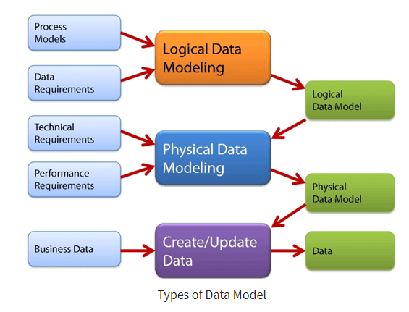
DATA MODELING CONCEPTS

Slide 34
DATA MODELING CONCEPTS
Conceptual Data Model
A Conceptual Data Model is an organized view of database concepts and their relationships. The purpose of creating a conceptual data model is to establish entities, their attributes, and relationships. In this data modeling level, there is hardly any detail available on the actual database structure.
The 3 basic tenants of Conceptual Data Model are
Entity: A real-world thing
Attribute: Characteristics or properties of an entity
Relationship: Dependency or association between two entities
Data model example:
Customer and Product are two entities. Customer number and name are attributes of the Customer entity
Product name and price are attributes of product entity
Sale is the relationship between the customer and product

Slide 35
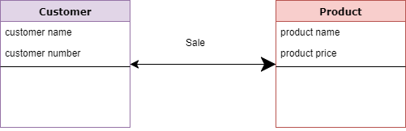
DATA MODELING CONCEPTS

Slide 36
DATA MODELING CONCEPTS
Characteristics of a conceptual data model
Offers Organization-wide coverage of the business concepts.
This type of Data Models are designed and developed for a business audience.
The conceptual model is developed independently of hardware specifications like data storage capacity, location or software specifications like DBMS vendor and technology. The focus is to represent data as a user will see it in the “real world.”
Conceptual data models known as Domain models create a common vocabulary for all stakeholders by establishing basic concepts and scope.

Slide 37
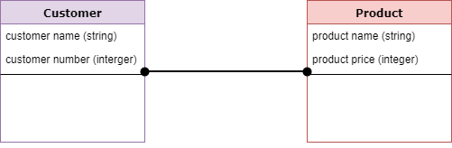
DATA MODELING CONCEPTS
Logical Data Model
The Logical Data Model is used to define the structure of data elements and to set relationships between them. The logical data model adds further information to the conceptual data model elements. The advantage of using a Logical data model is to provide a foundation to form the base for the Physical model. However, the modeling structure remains generic.

Slide 38
DATA MODELING CONCEPTS
Characteristics of a Logical data model
Describes data needs for a single project but could integrate with other logical data models based on the scope of the project.
Designed and developed independently from the DBMS.
Data attributes will have datatypes with exact precisions and length.
Normalization processes to the model is applied typically till 3NF.

Slide 39
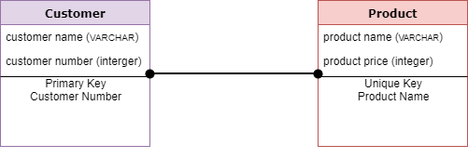
DATA MODELING CONCEPTS
Physical Data Model
A Physical Data Model describes a database-specific implementation of the data model. It offers database abstraction and helps generate the schema. This is because of the richness of meta-data offered by a Physical Data Model. The physical data model also helps in visualizing database structure by replicating database column keys, constraints, indexes, triggers, and other RDBMS features.

Slide 40
DATA MODELING CONCEPTS
Characteristics of a physical data model:
The physical data model describes data need for a single project or application though it maybe integrated with other physical data models based on project scope.
Data Model contains relationships between tables that which addresses cardinality and nullability of the relationships.
Developed for a specific version of a DBMS, location, data storage or technology to be used in the project.
Columns should have exact datatypes, lengths assigned and default values.
Primary and Foreign keys, views, indexes, access profiles, and authorizations, etc. are defined.

Slide 41
DATA MODELING CONCEPTS
Advantages of Data model:
The main goal of a designing data model is to make certain that data objects offered by the functional team are represented accurately.
The data model should be detailed enough to be used for building the physical database.
The information in the data model can be used for defining the relationship between tables, primary and foreign keys, and stored procedures.
Data Model helps business to communicate the within and across organizations.
Data model helps to documents data mappings in ETL process
Help to recognize correct sources of data to populate the model

Slide 42
DATA MODELING CONCEPTS
Disadvantages of Data model:
To develop Data model one should know physical data stored characteristics.
This is a navigational system produces complex application development, management. Thus, it requires a knowledge of the biographical truth.
Even smaller change made in structure require modification in the entire application.
There is no set data manipulation language in DBMS.

Slide 43
FLOW ORIENTED MODELING
It shows how data objects are transformed by processing the function. The Flow oriented elements are:
Data flow model
It is a graphical technique. It is used to represent information flow.
The data objects are flowing within the software and transformed by processing the elements.
The data objects are represented by labeled arrows. Transformation are represented by circles called as bubbles.
DFD shown in a hierarchical fashion.
The DFD is split into different levels. It also called as 'context level diagram'.

Slide 44
FLOW ORIENTED MODELING
2. Control flow model
Large class applications require a control flow modeling.
The application creates control information instated of reports or displays.
The applications process the information in specified time.
An event is implemented as a boolean value. For example, the boolean values are true or false, on or off, 1 or 0.
3. Control Specification
A short term for control specification is CSPEC.
It represents the behaviour of the system.
The state diagram in CSPEC is a sequential specification of the behaviour.
The state diagram includes states, transitions, events and activities.
State diagram shows the transition from one state to another state if a particular event has occurred.

Slide 45
FLOW ORIENTED MODELING
4. Process Specification
A short term for process specification is PSPEC.
The process specification is used to describe all flow model processes.
The content of process specification consists narrative text, Program Design Language(PDL) of the process algorithm, mathematical equations, tables or UML activity diagram.

Slide 46
SCENARIO BASED MODELING
Requirements for a computer-based system can be seen in many different ways.
Some software people argue that it’s worth using a number of different modes of representation while others believe that it’s best to select one mode of representation.
The specific elements of the requirements model are dedicated to the analysis modeling method that is to be used.
Scenario-based elements :
Using a scenario-based approach, system is described from user’s point of view. For example, basic use cases and their corresponding use-case diagrams evolve into more elaborate template-based use cases.

Slide 47
SCENARIO BASED MODELING
Class-based elements :
A collection of things that have similar attributes and common behaviors i.e., objects are categorized into classes. For example, a UML case diagram can be used to depict a Sensor class for the Safe Home security function. In addition to class diagrams, other analysis modeling elements depict manner in which classes collaborate with one another and relationships and interactions between classes.
Behavioral elements :
Effect of behavior of computer-based system can be seen on design that is chosen and implementation approach that is applied. Modeling elements that depict behavior must be provided by requirements model.

Slide 48
UML MODELING
Use-case diagrams describe the high-level functions and scope of a system. These diagrams also identify the interactions between the system and its actors. The use cases and actors in use-case diagrams describe what the system does and how the actors use it, but not how the system operates internally.
Use-case diagrams illustrate and define the context and requirements of either an entire system or the important parts of the system. You can model a complex system with a single use-case diagram, or create many use-case diagrams to model the components of the system. You would typically develop use-case diagrams in the early phases of a project and refer to them throughout the development process.

Slide 49
UML MODELING
Use cases
A use case describes a function that a system performs to achieve the user’s goal. A use case must yield an observable result that is of value to the user of the system.
Actors
An actor represents a role of a user that interacts with the system that you are modeling. The user can be a human user, an organization, a machine, or another external system.
Subsystems
In UML models, subsystems are a type of stereotyped component that represent independent, behavioral units in a system. Subsystems are used in class, component, and use-case diagrams to represent large-scale components in the system that you are modeling.

Slide 50
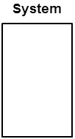

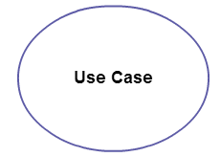
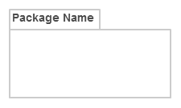
UML MODELING
In UML, a relationship is a connection between model elements. A UML relationship is a type of model element that adds semantics to a model by defining the structure and behavior between the model elements.

Slide 51
UML MODELING
Actor in a use case diagram is any entity that performs a role in one given system. This could be a person, organization or an external system and usually drawn like skeleton .
A use case represents a function or an action within the system. It’s drawn as an oval and named with the function.
The system is used to define the scope of the use case and drawn as a rectangle. This an optional element but useful when you’re visualizing large systems. For example, you can create all the use cases and then use the system object to define the scope covered by your project.
The package is another optional element that is extremely useful in complex diagrams. Similar to class diagrams, packages are used to group together use cases.

Slide 52
UML MODELING
There are five types of relationships in a use case diagram. They are
Association between an actor and a use case
Generalization of an actor
Extend relationship between two use cases
Include relationship between two use cases
Generalization of a use case
How to create use case diagram:-
Identifying Actors
Actors are external entities that interact with your system. It can be a person, another system or an organization. In a banking system, the most obvious actor is the customer. Other actors can be bank employee or cashier depending on the role you’re trying to show in the use case.

Slide 53
UML MODELING
Identifying Use Cases
Now it’s time to identify the use cases. A good way to do this is to identify what the actors need from the system. In a banking system, a customer will need to open accounts, deposit and withdraw funds, request check books and similar functions. So all of these can be considered as use cases.
Top level use cases should always provide a complete function required by an actor. You can extend or include use cases depending on the complexity of the system.
Look for Common Functionality to use Include
Look for common functionality that can be reused across the system. If you find two or more use cases that share common functionality you can extract the common functions and add it to a separate use case. Then you can connect it via the include relationship to show that it’s always called when the original use case is executed.

Slide 54
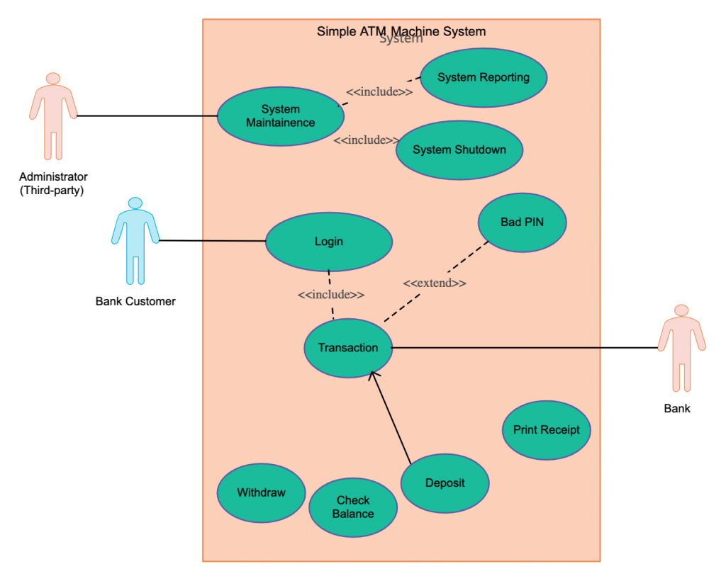
UML MODELING

Slide 55
REQUIREMENTS MODELING FOR WEB AND MOBILE APPS
The following size-related variables dictate how much focus is placed on requirements modelling for Web and mobile applications:
(1) The scope and intricacy of the application increment;
(2) The quantity of stakeholders (analysis can assist in identifying conflicting requirements originating from various sources);
(3) The size of the app development team;
(4) The extent to which team members have collaborated previously analysis can aid in creating a shared understanding of the project); and
(5) The duration elapsed since the team's last collaboration.

